Slide 1
Module 4: Business Continuity, Backup & Archive
Dr. S. Nandagopalan

Slide 2
Syllabus
Module 4 (8 hours)
Chapter 9: Introduction to Business Continuity
Information Availability
BC Terminology
BC Planning Life Cycle
Failure Analysis
Business Impact Analysis
BC Technology Solution
Chapter 10 : Backup and Archive:
Backup Purpose
Backup Considerations
Backup Granularity
Recovery Considerations
Backup Methods
Backup Architecture
Backup and Restore Operations
Backup Topologies
Backup in NAS Environments

Slide 3
Chapter 9
Introduction to Business Continuity (BC)

Slide 4
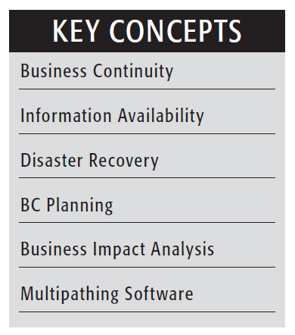
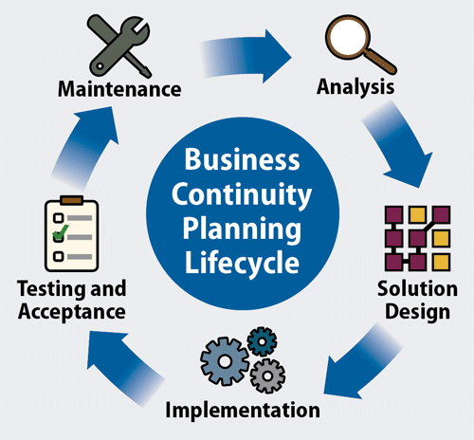
Introduction
Business continuity (BC) is about having a plan to deal with difficult situations, so your organization can continue to function with as little disruption as possible.
Business continuity (BC) is an integrated and enterprisewide process that includes all activities (internal and external to IT) that a business must perform to mitigate the impact of planned and unplanned downtime.
Goal of BC – “information availability”
https://www.youtube.com/watch?v=cxE940f7iq0
https://www.youtube.com/watch?v=izQ98tRCbdg

Slide 5
Information Availability
It is the ability of an IT infrastructure to function according to business expectations during its specified time of operation.
The employees, customers, suppliers, and partners can access information whenever they need it.
Accessibility: Information should be accessible at the right place, to the right user.
Reliability: Information should be reliable – no corruption of data.
Timeliness: Defines the exact moment or the time window during which information must be accessible (8.30AM-04.00PM)

Slide 6
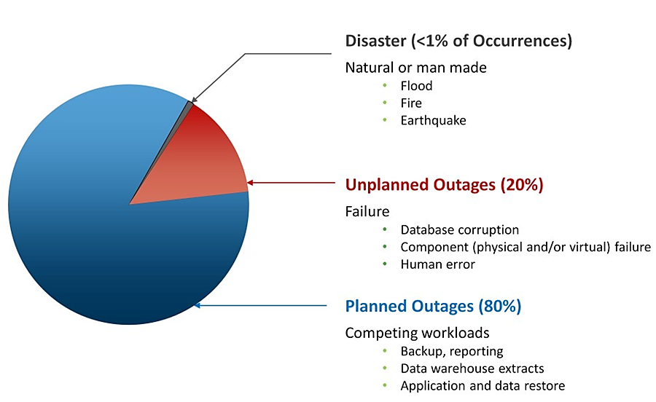
(a) Causes of Information Unavailability
Planned outages include installation/integration/maintenance of new hardware, software upgrades or patches, taking backups, application and data restores, facility operations (renovation and construction), and refresh/migration of the testing to the production environment.
Unplanned outages include failure caused by human errors, database corruption, and failure of physical and virtual components.

Slide 7
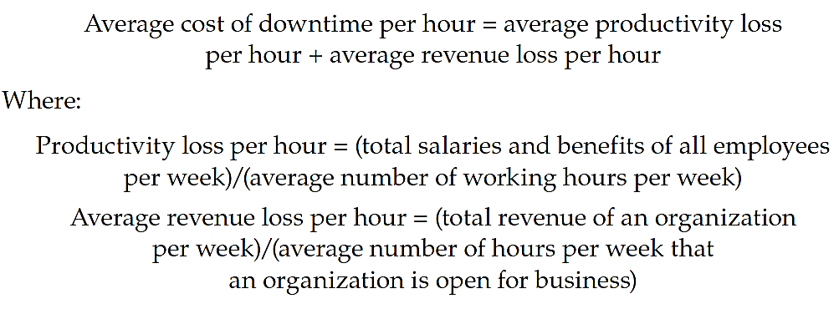
(b) Consequences of Downtime
average cost of downtime per hour, provides a key estimate in determining the appropriate BC solutions
According to Gartner, the average cost of IT downtime is $5,600 per minute. Because there are so many differences in how businesses operate.
low = $140,000 per hour, average = $300,000 per hour high = $540,000 per hour

Slide 8
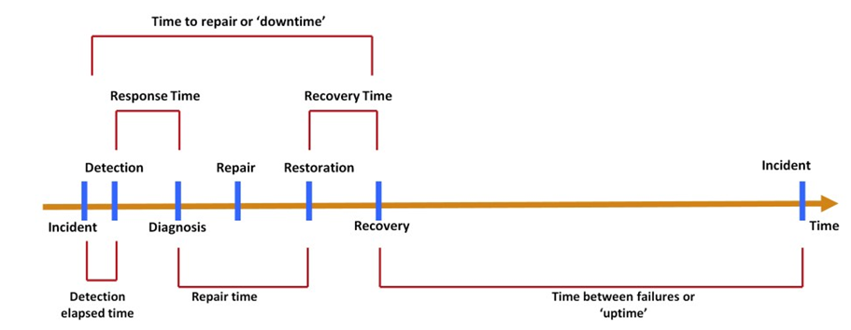
(c) Measuring Information Availability
Mean Time Between Failure (MTBF): It is the average time available for a system or component to perform its normal operations between failures (in hours).
Mean Time To Repair (MTTR): It is the average time required to repair a failed component.
Information availability metrics

Slide 9
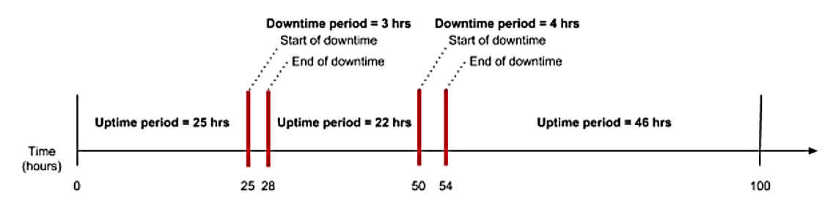
How to calculate MTBF & MTTR?
MTBF = Total uptime / # of breakdowns
Example:
MTBF = (25 + 22 + 46 ) / 2 breakdowns
= 93 / 2 breakdowns = 46.5 hours
MTTR = Total downtime / # of breakdowns
MTTR = (3+4) / 2 = 4.5 hours

Slide 10
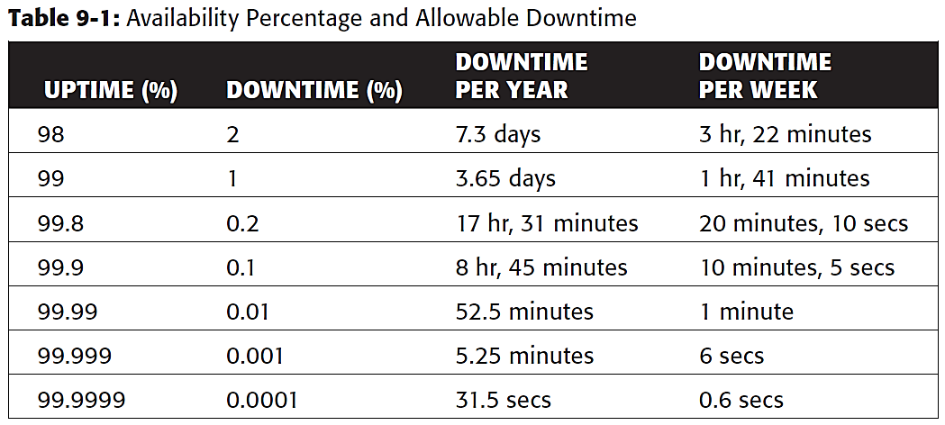
Uptime/Downtime
Uptime - the time your system is available for use as intended.
Downtime - the time your system is stalled, shut down, or otherwise not working according to plan.
IA = system uptime/(system uptime + system downtime)
Or, IA = MTBF/(MTBF + MTTR)

Slide 11
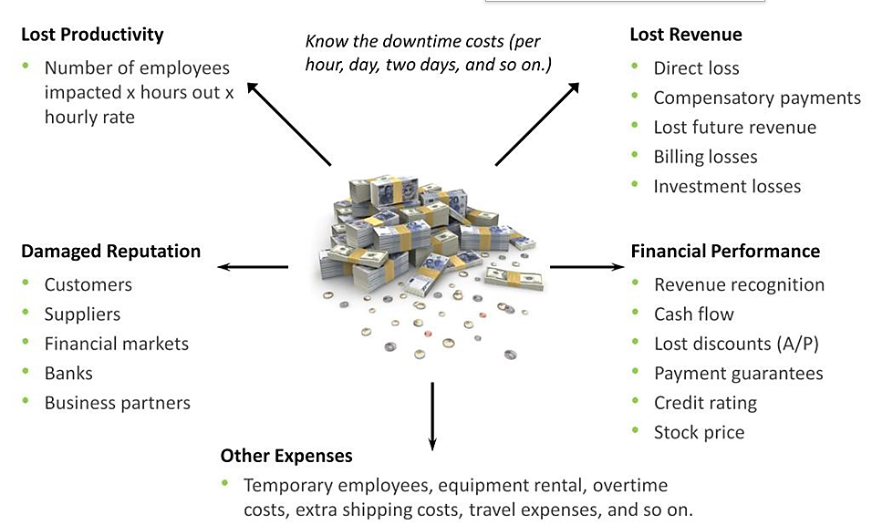
Impact of Downtime

Slide 12
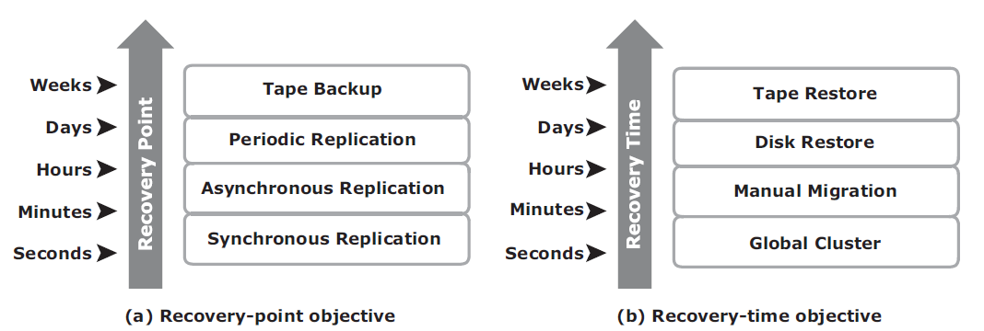
BC Terminology
Disaster recovery: This is the coordinated process of restoring systems, data, and the infrastructure after a disaster.
Disaster restart: This is the process of restarting business operations with mirrored consistent copies of data and applications.
Recovery-Point Objective (RPO): This is the point in time to which systems and data must be recovered after an outage. Based on the RPO, organizations plan for the frequency with which a backup or replica must be made.

Slide 13
BC Terminology…
Recovery-Time Objective (RTO): The time within which systems and applications must be recovered after an outage. It defines the amount of downtime that a business can endure and survive.
RTO of 72 hours: Restore from tapes available at a cold site.
RTO of 12 hours: Restore from tapes available at a hot site.
RTO of few hours: Use of data vault at a hot site.
RTO of a few seconds: Cluster production servers with bidirectional mirroring, enabling the applications to run at both sites simultaneously.
Data vault: Copy data from a remote site.
Hot site: A site where an enterprise’s operations can be moved in the event of disaster – activated.
Cold site: same as hot site – not activated.
Server Clustering: A group of servers and other necessary resources coupled to operate as a single system.

Slide 14
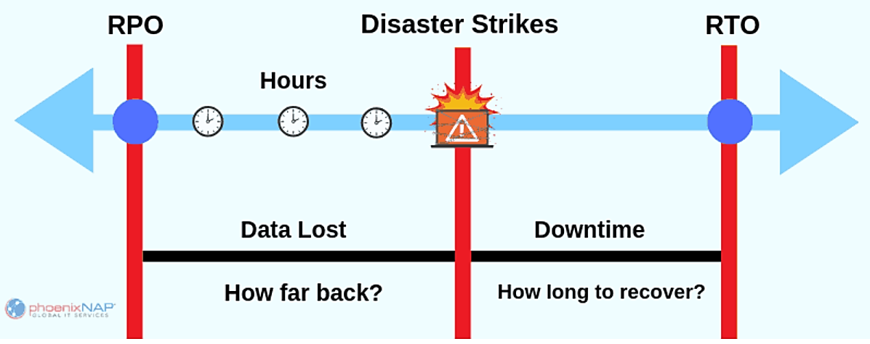
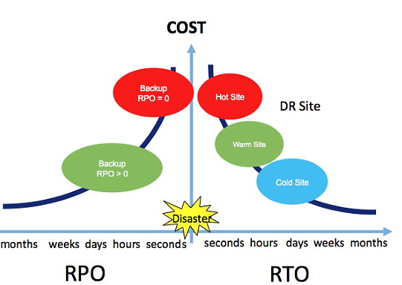
RPO vs. RTO
Example – RPO:
If the last available good copy of data upon an outage is from 18 hours ago.
Let RPO = 20 hours. We are safe!
Example – RTO: “timeframe within which applications and systems must be restored after an outage.“
Let RTO = 6 hours.
The Microsoft Exchange Server, applications that include emails, calendar and collaboration services (such as Teams) should be recovered within 6 hours after outage.

Slide 15
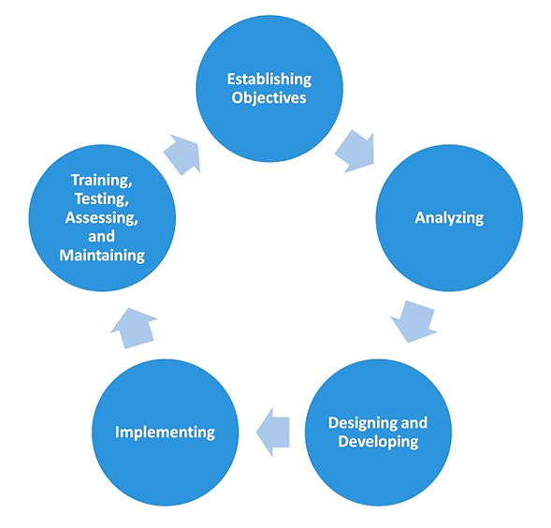
BC Planning Life Cycle
The BC planning life cycle includes five stages:
Establishing objectives
Analyzing
Designing and developing
Implementing
Training, testing, assessing, and maintaining

Slide 16
BC Planning Life Cycle…
1. Establish objectives:
Determine BC requirements.
Estimate the scope and budget to achieve requirements.
Select a BC team that includes subject matter experts from all areas of business, whether internal or external.
Create BC policies.
2. Analysis:
Collect information on data profiles, business processes, infrastructure support, dependencies, and frequency of using business infrastructure.
Conduct a Business Impact Analysis (BIA).
Identify critical business processes and assign recovery priorities.
Perform risk analysis.
Perform cost benefit analysis

Slide 17
BC Planning Life Cycle…
3. Design and develop:
Define the team structure and assign individual roles and responsibilities.
Design data protection strategies and develop infrastructure.
Develop contingency solutions.
Develop emergency response procedures.
Detail recovery and restart procedures.
4. Implement:
Implement risk management and mitigation procedures that include backup, replication, and management of resources.
Prepare the disaster recovery sites that can be utilized if a disaster affects the primary data center.
Implement redundancy for every resource in a data center to avoid single points of failure.

Slide 18
BC Planning Life Cycle…
5. Train, test, assess, and maintain:
Train the employees who are responsible for backup and replication.
Train employees on emergency response procedures
Train the recovery team
Perform damage-assessment processes and review recovery plans.
Test the BC plan regularly to evaluate its performance and identify its limitations.
Assess the performance reports and identify limitations.
Update the BC plans and recovery/restart procedures to reflect regular changes within the data center.

Slide 19
Failure Analysis
Analyze the physical and virtual infrastructure components to identify single point of failure.
Implement fault-tolerance mechanisms.

Slide 20
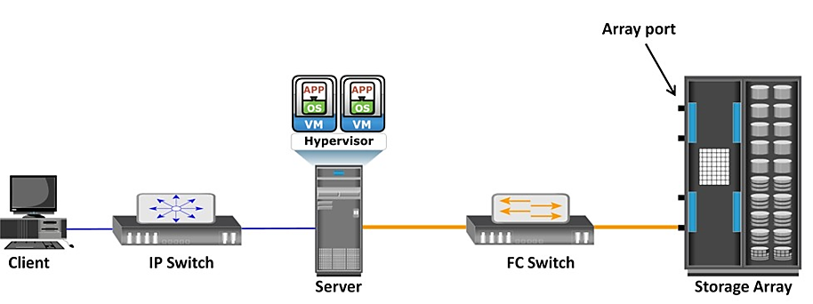
Single Point of Failure
The failure of a component that can terminate the availability of the entire system or IT service.
E.g. A VM, a hypervisor, an HBA/NIC on the server, the physical server, the IP network, the FC switch, the storage array ports, or even the storage array could be a potential single point of failure.

Slide 21
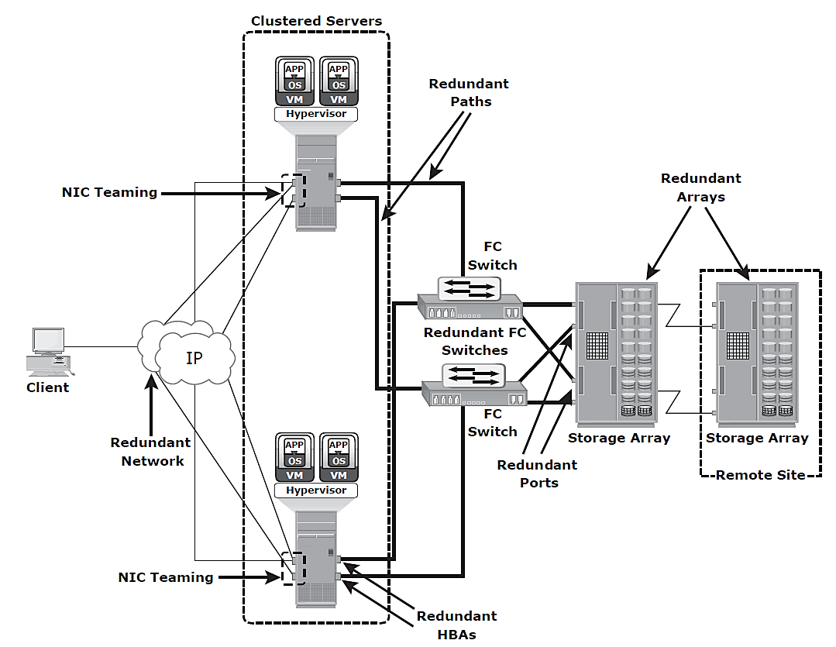
Resolving Single Points of Failure
Solution – redundancy
Data centers follow stringent guidelines to implement fault tolerance for uninterrupted information availability.

Slide 22
Business Impact Analysis
A business impact analysis (BIA) identifies which business units, operations, and processes are essential to the survival of the business.
Financial
Operational
Service impacts of a disruption to essential business processes
Report – money or time

Slide 23
Tasks of BIA
Determine the business areas.
For each business area, identify the key business processes critical to its operation.
Determine the attributes of the business process in terms of applications, databases, and hardware and software requirements.
Estimate the costs of failure for each business process.
Calculate the maximum tolerable outage and define RTO and RPO for each business process.
Establish the minimum resources required
Determine recovery strategies and the cost for implementing them.
Optimize the backup and business recovery strategy based on business priorities.
Analyze the current state of BC readiness and optimize future BC planning.

Slide 24
BC Technology Solutions
Solutions to recover from a failure:
Backup
Data backup is for data availability. The frequency of backup is determined based on RPO, RTO, and the frequency of data changes.
Local replication
Data can be replicated to a separate location within the same storage array (used for data corruption also.)
Remote replication
Data in a storage array can be replicated to another storage array located at a remote site.

Slide 25
Chapter 10 Backup and Archive

Slide 26
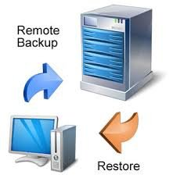

Introduction
What is Backup? - It is an additional copy of production data, created and retained for the sole purpose of recovering lost or corrupted data.
Organizations need a quick restore of backed up data to meet business service-level agreements (SLAs).
Evaluation of methods for the successful backup and recovery solution is mandatory.
Large volume of data is fixed. Backup of fixed storage increases the cost.
What is Data archiving? – It is the process of moving data that is no longer actively used, from primary storage to a low-cost secondary storage. Retaining data for long-term storage. No need to backup!
Local or

Slide 27
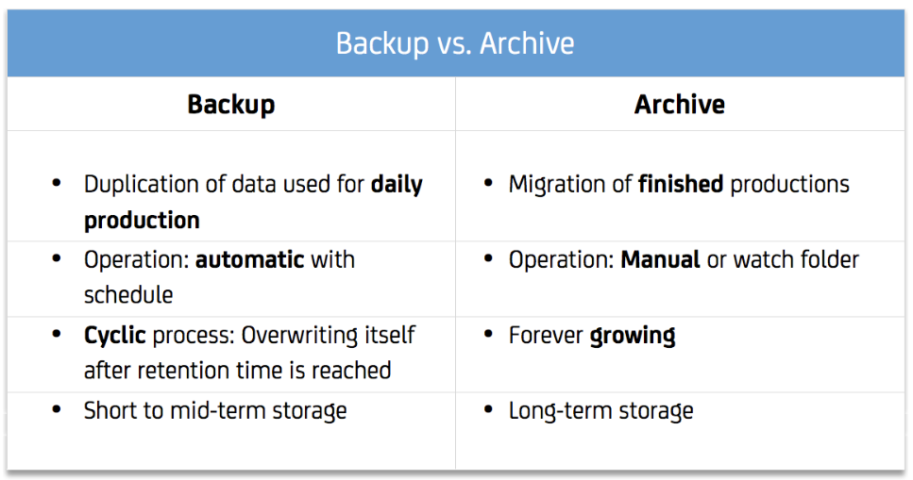
Backup Vs. Archive

Slide 28
What is the purpose of Backup?
(a) Disaster Recovery
The purpose of the backup is to create a copy of data (in tapes) that can be recovered in the event of a primary data failure.
Primary data failures can be the result of hardware or software failure, data corruption, or a human-caused event, such as a malicious attack (virus or malware), or accidental deletion of data.
Backup copies allow data to be restored from an earlier point in time to help the business recover from an unplanned event.
(b) Operational Recovery
Data in the production environment changes with every business transaction and operation.
Backups are used to restore data if data loss or logical corruption occurs during routine processing.

Slide 29

What is the purpose of Backup? (contd.)
(c) Archival
It is the process of moving data that is no longer actively used to a separate storage device for long-term retention.
Backups are also performed to address archival requirements.
Content Addressed Storage (CAS) - the system will record a content address, which is an identifier uniquely and permanently linked to the information content itself. To retrieve, this identifier is enough.
Traditional methods are still in place!

Slide 30
What is CAS?
Content addressed storage or CAS is an object-based system that has been made for storing and managing fixed content data. It is designed for secure online storage and recovery of fixed content.
Unlike file-level and block-level data access that use file names and the physical location of data for storage and recovery, CAS stores user data and its information as separate objects. The stored object is assigned a globally unique address known as a content address (CA).
Example: Electronics data such as contracts, claims, E-mail attachment, Digital record such as Photos, checks etc. and Rich Media such as X-Ray, CT Scan, Voice mail, radio, etc.

Slide 31
Backup Considerations
Backup strategy - amount of data loss and downtime
RPO – decides backup frequency (e.g. RPO = 1 day then everyday backup must be taken)
Retention period – duration to retain the backup data
Backup media type - depends on RTO
Backup granularity - location, size, number of files, and data compression

Slide 32
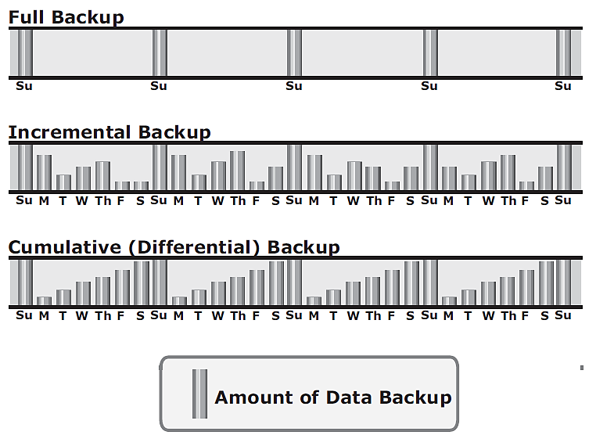
Backup Granularity
Granularity levels - full, incremental and cumulative (differential).
Full backup - backup of the complete data on the production volumes.
Incremental backup - copies the data that has changed since the last full or incremental backup, whichever has occurred more recently.
Cumulative backup - copies the data that has changed since the last full backup.

Slide 33
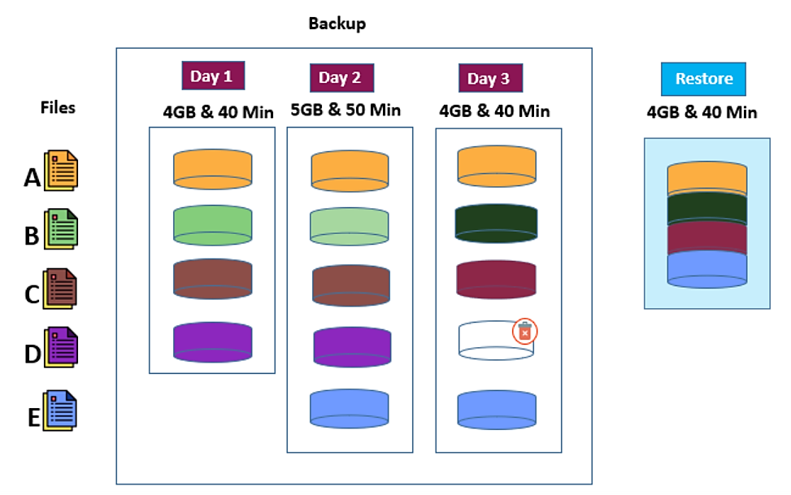
Example – Full Backup

Slide 34
Full backup (contd.)
Let’s take an example – say you have 4 files A, B, C, and D. And let’s say each of them is about 1GB each and each of them takes 10 mins to backup.
On Day 1 – you’ll backup 4GB and it’ll take you 40 mins
On Day 2, let’s say File B changes to B1, and a new File called E is added. A-C & D remain the same.
Hence, you run the backup on Day 2, it’ll backup all 5 files and it’ll take you 50mins.
One Day 3, let’s say File B changes again and becomes B2. File C also changes to C1, and File D gets deleted.
When you run the backup on Day 3, it’ll backup 4 files again (D is removed – remember?) and it’ll take you 40 mins.
When you restore, you will most likely get data from the latest backup and it’ll take you 40 mins to restore.

Slide 35
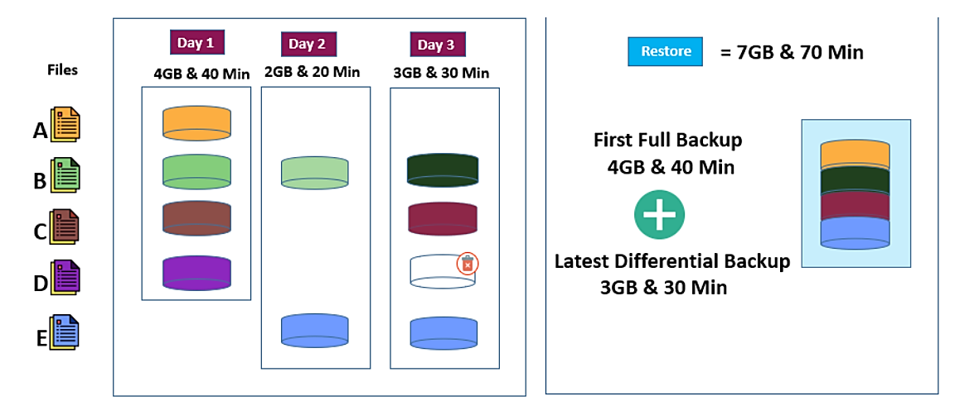
Example – Cumulative Backup

Slide 36
Cumulative/Differential backup…
Let’s take the same example – say you have 4 files A, B, C, and D. And let’s say each of them is about 1GB each and each of them takes 10 mins to backup
On Day 1 – you’ll backup 4GB and it’ll take you 40 mins
On Day 2, let’s say File B changes to B1, and a new File called E is added. Files A, C & D stay the same.
When you run the backup on Day 2, it’ll backup just the 2 changed files and the backup will take you 20mins
One Day 3, let’s say File B changes again and becomes B2. File C also changes to C1 and File D gets deleted.
When you run the backup on Day 3, it’ll backup 3 files (B2, C1, and E) and it’ll take you 30 mins. Why did we backup E? Remember a differential backup picks up everything that changed since the full backup.
When you restore data, just like in the previous case – you’ll need to restore the Full backup first – and then layer in each incremental backup on top of that – in order.

Slide 37
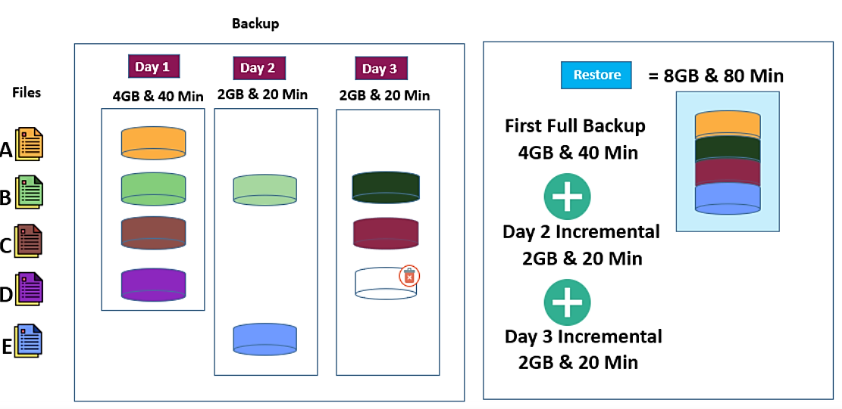
Example - Incremental backup

Slide 38
Incremental…
So, you have 4 files A, B, C, and D. And let’s say each of them is about 1GB each and each of them takes 10 mins to backup
On Day 1 – you’ll backup 4GB and it’ll take you 40 mins
On Day 2, let’s say File B changes to B1, and a new File called E is added.
When you run the backup on Day 2, it’ll backup just the 2 changed files – and it’ll take you 20 mins
One Day 3, let’s say File B changes again to B2. File C also changes to C1 and File D gets deleted.
When you run the backup on Day 3, it’ll backup just the 2 files again (B2 and C1) (D is removed – remember?) and it’ll take you 20 mins
When you restore data, just like in the previous case – you’ll need to restore the Full backup first – and then layer in each incremental backup on top of that – in order.

Slide 39
Recovery Considerations
The retention period (from RPO) - key consideration for recovery
E.g. Assume that the data backup was done a month ago. A request for data retrieval means – retention period is ONE month.
If the recovery point is older than the retention period, it might not be possible to recover all the data required for the requested recovery point.
To minimize recovery time – choose proper backup granularity

Slide 40
Backup Methods
Methods - Hot backup and cold backup
Hot backup (Online)- the application is up-and-running, with users accessing their data during the backup process. Data duplication/cluster, etc.
Cold backup (Offline) - requires the application to be shut down during the backup process. USB, external hard drive, cloud, etc.

Slide 41
(a) Hot Backup
If a file is open, it is normally not backed up during the backup process. In such situations, an open file agent is required to back up the open file.
These agents interact directly with the operating system or application and enable the creation of consistent copies of open files.
In database environments, the use of open file agents is not enough, because the agent should also support a consistent backup of all the database components.
CONS: the agents affect the overall application performance.

Slide 42
(b) Cold Backup
The database operations are entirely stopped, and then the backup is performed.
While the backup is in progress, no business operations can be performed - done before the beginning of the day or at the end of the day.
Point-in-time (PIT) copy - is created from the production volume and used as the source for the backup.
Bare-metal recovery (BMR) - backup all metadata, system information, and application configurations for a full system recovery.

Slide 43
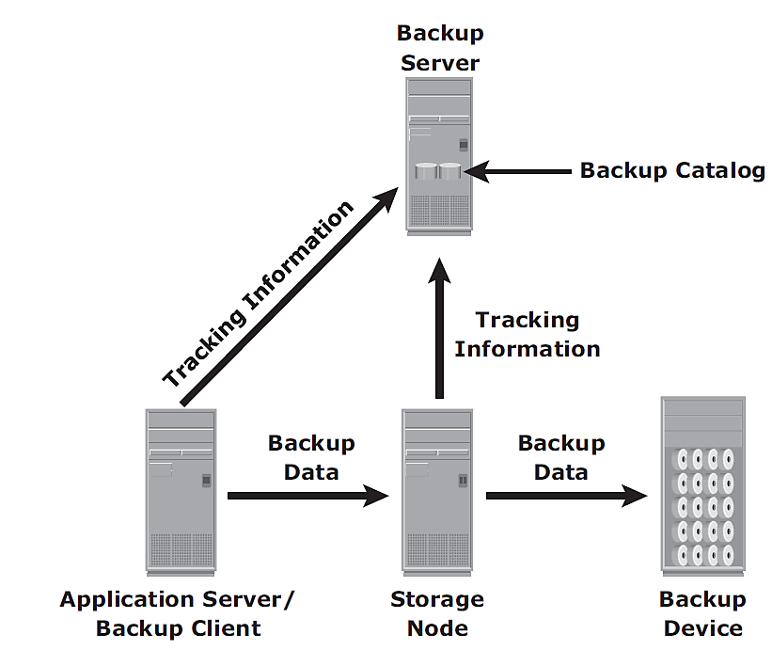
Backup Architecture
Client-server architecture with a backup server and multiple backup clients.
Backup server - manages the backup operations and maintains the backup catalog (if it is lost?!).
Backup client - to gather the data that is to be backed up and send it to the storage node.
Storage node - is responsible for writing the data to the backup device.

Slide 44
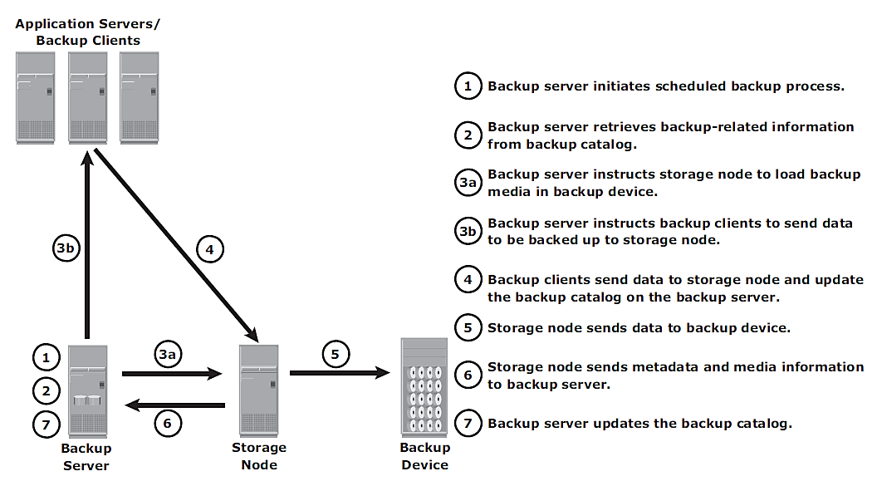
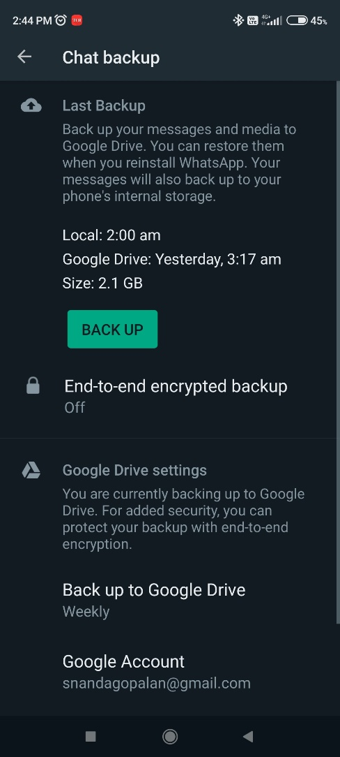
(a) Backup Operation
The backup operation - initiated by a server or client (11.00PM everyday)
Backup operation

Slide 45
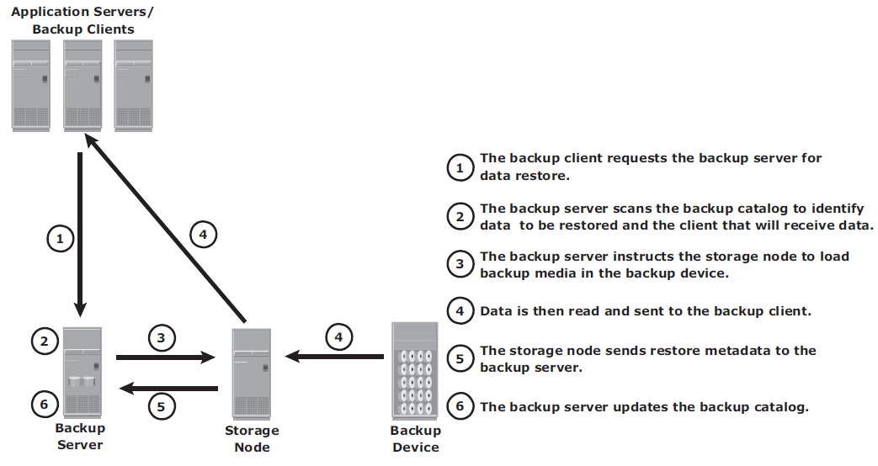
(b) Restore Operation
Restore operation

Slide 46
Backup Topologies
Direct-attached backup
LAN-based backup
SAN-based backup
Mixed - LAN-based and SAN-based topologies

Slide 47
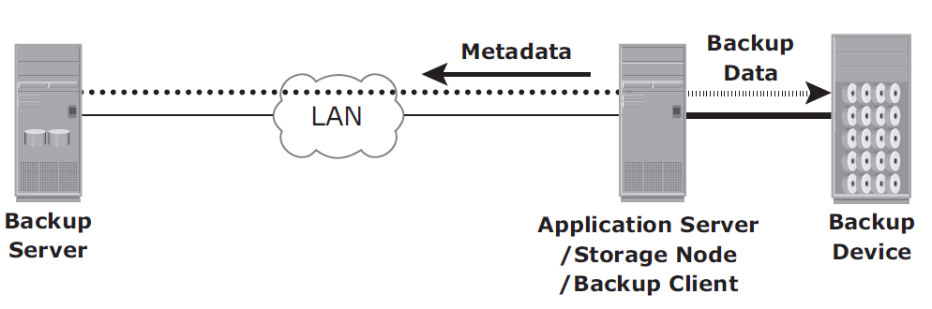
(a) Direct-attached backup
Storage node is configured on a backup client.
Backup device is attached directly to the client.
Only the metadata is sent to the backup server through the LAN.

Slide 48




Example - WhatsApp
The contents of messages that have been delivered by the WhatsApp Service are not copied, kept or archived by WhatsApp.
The undelivered message is held in WhatsApp's server until it can be delivered (max. 30 days).
The contents of any delivered messages are not kept or retained by WhatsApp.
Metadata - date and time stamp information, mobile phone numbers, etc.
Meta Data
User Mobile/Client
Backup Data
WhatsApp Server

Slide 49
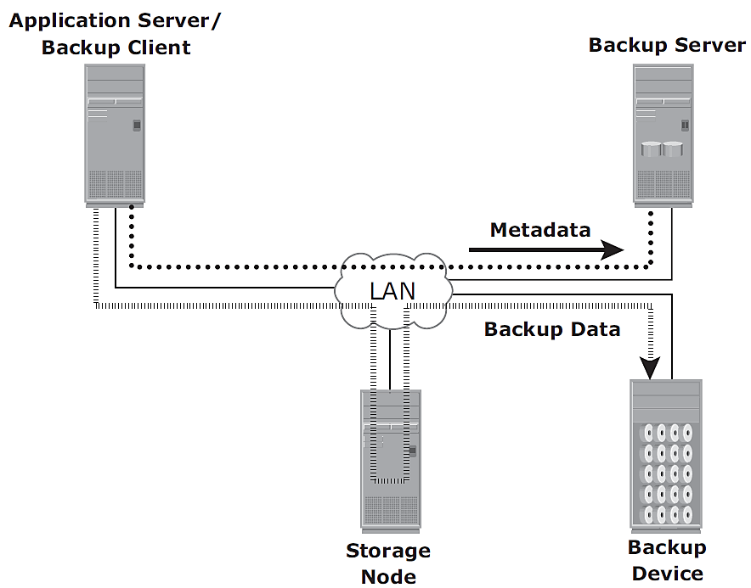
(b) LAN-based backup
In a LAN-based backup, the clients, backup server, storage node, and backup device are connected to the LAN

Slide 50
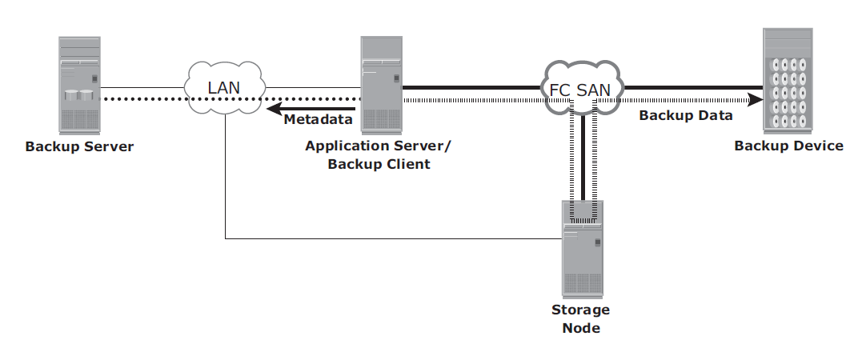
(c) SAN-based backup
The backup device and clients are attached to the SAN (for sharing)
A client sends the data to be backed up to the backup device over the SAN.
The backup data traffic is restricted to the SAN, and only the backup metadata is transported over the LAN.
The volume of metadata is insignificant when compared to the production data; the LAN performance is not degraded in this configuration.

Slide 51
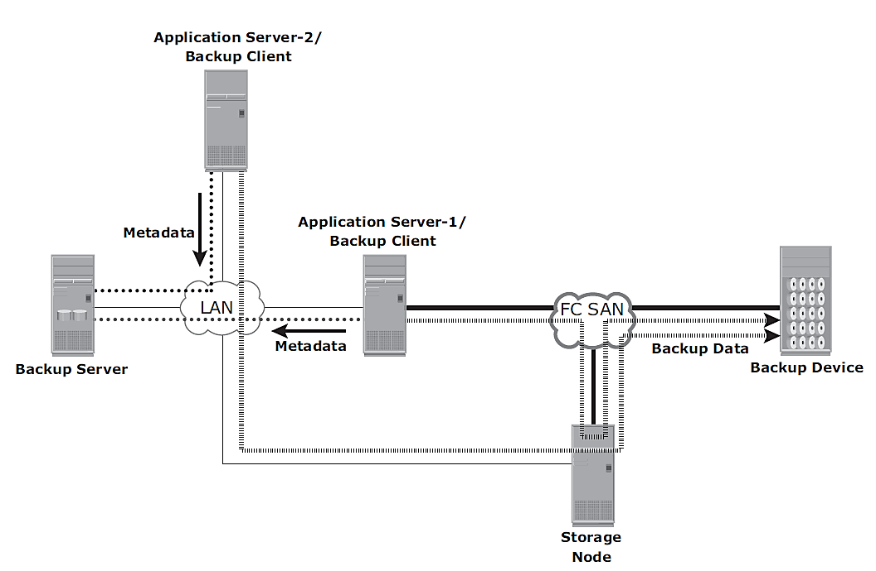
(d) Mixed topology

Slide 52
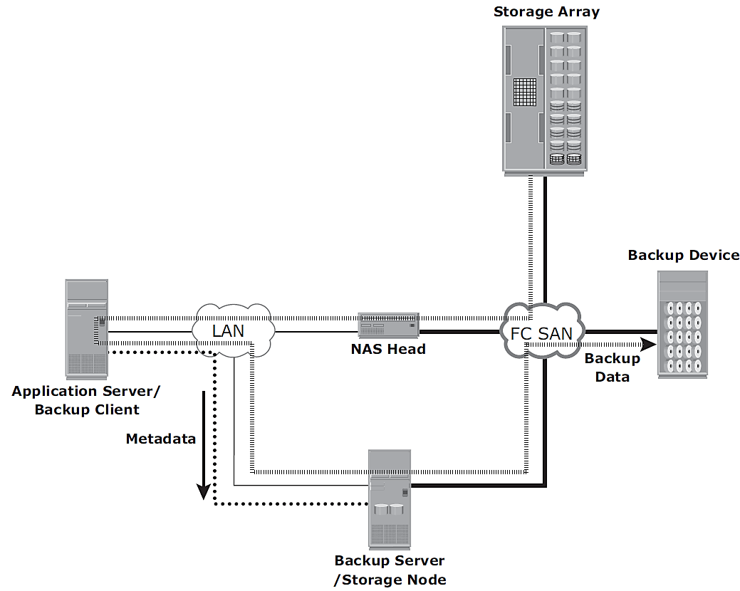
Backup in NAS Environments
(a) Server-based Backup
NAS head retrieves data from a storage array over the network and transfers it to the backup client running on the application server.
The backup client sends this data to the storage node, which in turn writes the data to the backup device.
This results in overloading the network with the backup data and using application server resources to move the backup data.

Slide 53
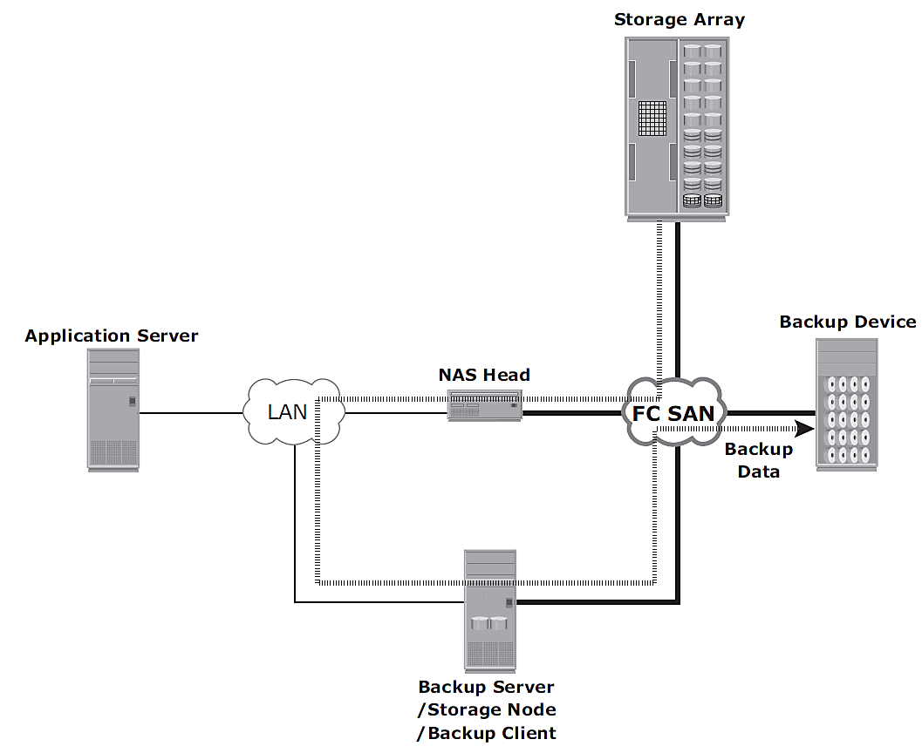
Backup in NAS Environments…
(b) Server-less Backup
The network share is mounted directly on the storage node. This avoids overloading the network during the backup process and eliminates the need to use resources on the application server.
In this scenario, the storage node, which is also a backup client, reads the data from the NAS head and writes it to the backup device without involving the application server.
Compared to the previous solution, this eliminates one network hop.

Slide 54
What is NDMP?
Network Data Management Protocol – NDMP
To solve the problem of backing up networks of heterogeneous file servers, including dedicated file servers ("filers"), with any of several backup applications.
NDMP enables the creation of a "universal agent" for the network- attached file servers to be used by any of the centralized backup administration applications.
Why NDMP for NAS?
NAS devices, which are dedicated file servers, are not connected to networks through a central server, so they must have their own operating system (OS)
Administrators must mount every NAS volume using either Network File System or Common Internet File System from a network server that does host a backup software agent. This cumbersome method increases network traffic and degrades performance.

Slide 55
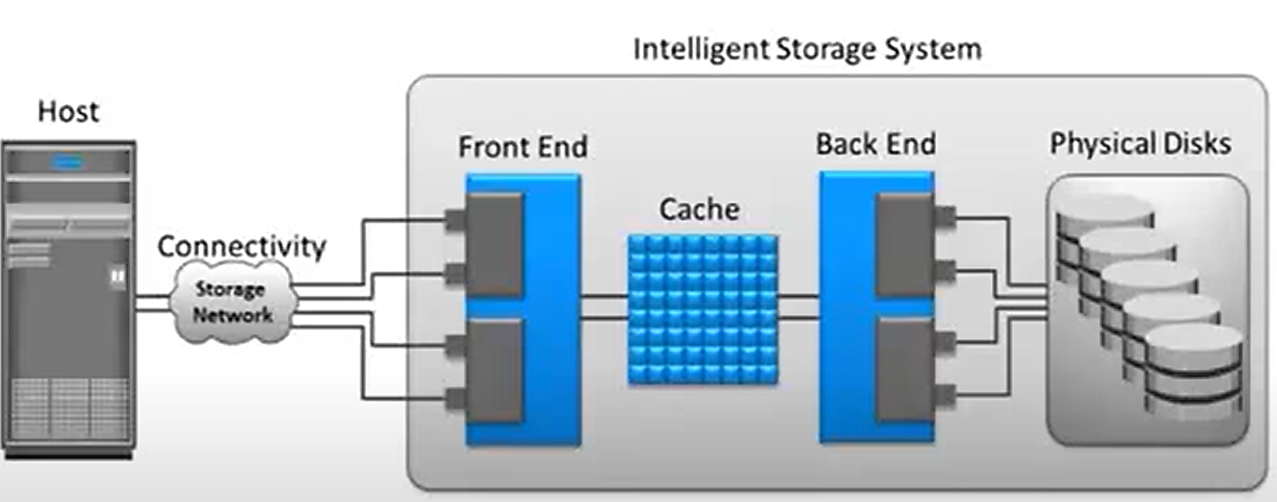
What are the different topologies of an NDMP protocol?
Terminologies:
Data Volume to be backed up
Tape Drive where the backup will be written
Data Management Application (DMA) - Backup Application
Storage controller/Storage Processor - a server that’s responsible for performing a range of functions for the storage system
Direct
2-way or Indirect
3-way

Slide 56
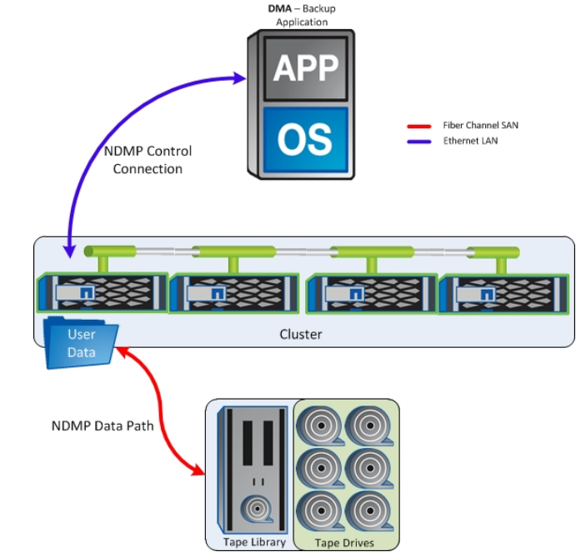
(1) Direct Topology
In a Direct model, the controller that owns the volume also has a locally attached (can also be connected through a switch using a SAN) Tape Drive.
Here the DMA will create a control connection to the storage controller and create a data connection that is local to the controller.
This will allow the controller to back up the local volume to the locally attached Tape Drive.

Slide 57

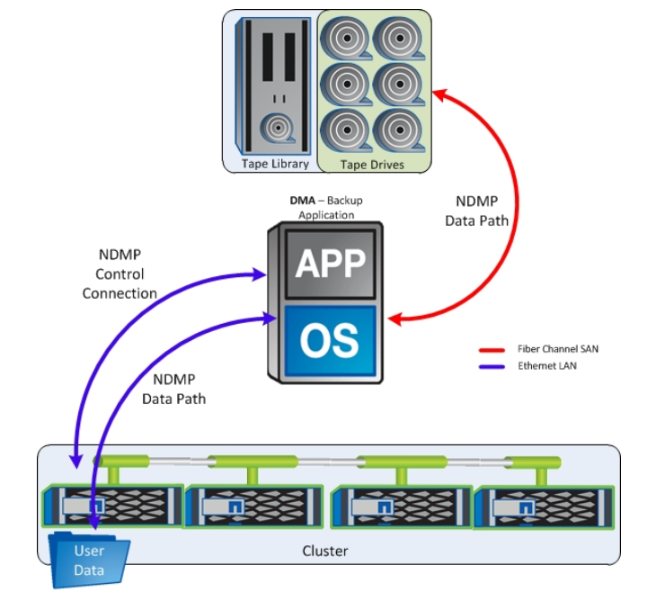
(2) 2-Way or Indirect
In an In-Direct model, the controller that owns the volume does NOT have any tape drives attached to it.
DMA will create a control connection to the storage controller and create a remote data connection back to itself (the DMA).
When the backup begins, the DMA will ingest the backup data from the controller and in turn, write the NDMP backup to a tape drive connected to the DMA.
Direct
2-Way

Slide 58
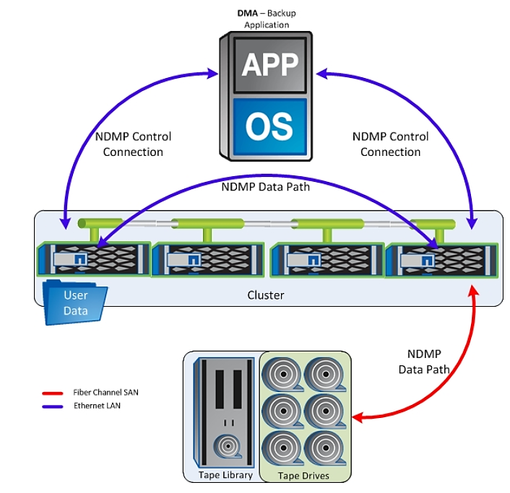
(3) 3-Way Topology
In a 3-way model, there are multiple storage controllers each owning different resources.
The first storage controller will own the data volume that is to be backed up.
The second storage controller will own the tape drive that will be used for the backup.
Here the DMA will create control connection to BOTH controllers (one connection to control the data volume, and other connection to control the tape drive) and instruct the Storage controllers to create a data connection between themselves.
When the backup begins, the data will be read from the first storage controller and be written to the tape drive connected to the second storage controller.

Slide 59
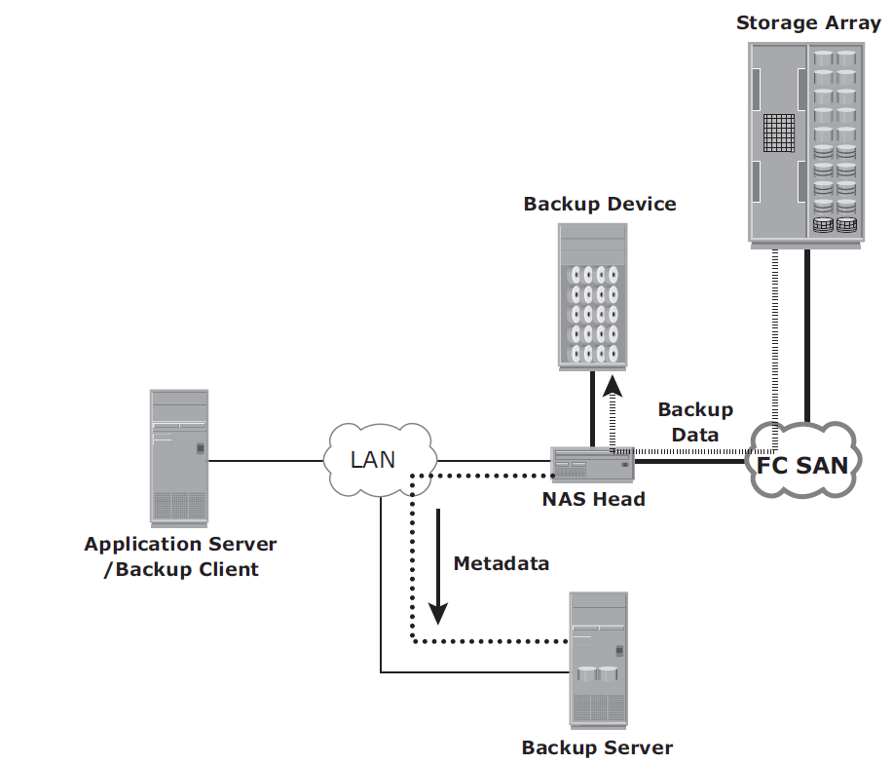
NDMP based Backup in NAS Environments…
(c) NDMP 2-way
It enables localized backups and disaster recovery and minimizes demands on network resources.
NDMP is an industry-standard TCP/IP-based protocol specifically designed for a backup in a NAS - common protocol for the backup architecture.
Data can be backed up using NDMP regardless of the OS.
No need to go via application server. Uses high speed connection.
Network traffic is minimized by isolating data movement from the NAS head to the locally attached backup device.

Slide 60
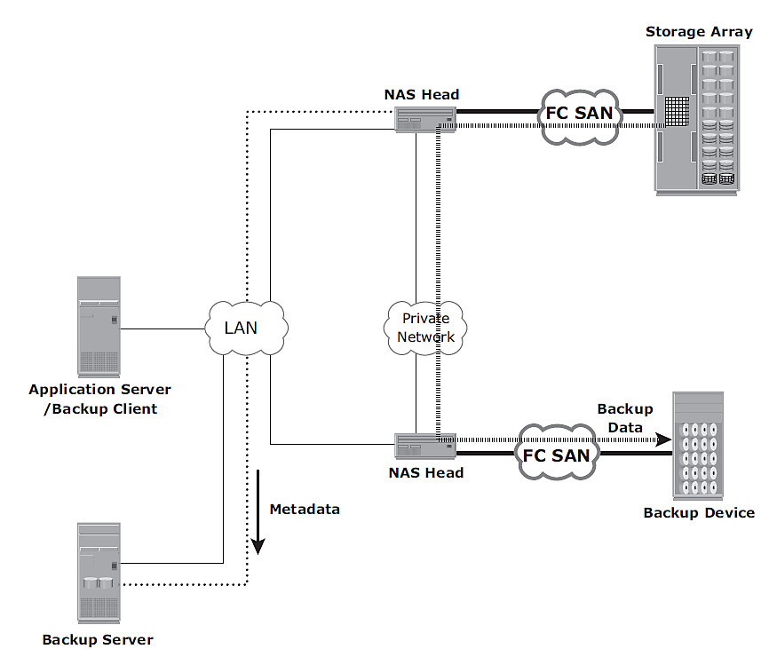
NDMP based Backup in NAS Environments…
(d) NDMP 3-way
A separate private backup network must be established between all NAS heads and the NAS head connected to the backup device.
Metadata and NDMP control data are still transferred across the public network.
It is useful when backup devices need to be shared among NAS heads.

Slide 61
Review Questions
Define Business Continuity. Explain BC terminology in detail.
Describe the Business Continuity Life Cycle.
How do you perform Failure Analysis?
What do you understand by BIA? List the major tasks of BIA.
Discuss different backup topologies.
Explain the concept of Backup in virtualized environments.
What is the purpose of Backup? Explain with few examples.
What do you understand by (i) full backup (ii) cumulative backup (c) incremental backup?
Explain the steps involved during backup & restore operations? Explain with neat diagrams.
Bring out the concepts of various Backup/Restore topologies.
Write various planned and unplanned occurrences of information unavailability in the context of data center operations.

Slide 62
Qn. 12
The IT department of a bank provide customers access to the currency conversion rate table between 9:00 a.m. and 4:00 p.m. from Monday through Friday. It updates the table every day at 8:00 a.m. with a feed from the mainframe system. The update process takes 35 minutes to complete. On Thursday, due to a database corruption, the rate table could not be updated. At 9:05 a.m., it was identified that the table had errors. A rerun of the update was done, and the table was re-created at 9:45 a.m. Verification was run for 15 minutes, and the rate table became available to the bank branches. What was the availability of the rate table for the week in which this incident took place, assuming there were no other issues?
Answer:
IA = Uptime/(Uptime+Downtime) = 34/(34+1) = 97.1%

Slide 63
Exercise (Contd.)
A system has three components and requires all three to be operational 24 hours, Monday through Friday. Failure of component 1 occurs as follows:
Monday = No failure
Tuesday = 5 a.m. to 7 a.m.
Wednesday = No failure
Thursday = 4 p.m. to 8 p.m.
Friday = 8 a.m. to 11 a.m.
Calculate the MTBF (Mean Time Between Failure) and MTTR (Mean Time To Repair) of component 1.
Solution:
MTBF = ((24 Hours * 5 days) – (2+4+3)) / 3 = 111/3 = 37 hours
MTTR = 9 / 3 = 3 hours

